Slide 1
Software Engineering and Architecture
Broker II: Dispatching

Slide 2
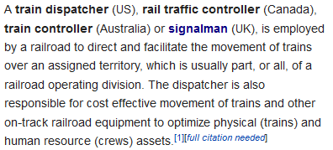
Dispatching
In computing, dispatchers are responsible for distributing incoming messages efficiently

Slide 3
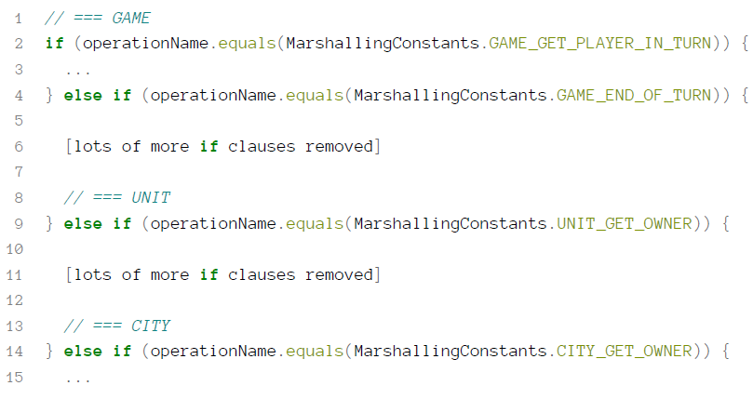
Invoker Becomes The Blob
Consider HotCiv’s Invoker’s ‘handleRequest’:
HotStone equivalent: Game, Card, Hero

Slide 4
Blobs do not scale
Consider 20 remote roles
Thus the invoker handles twenty different servant classes
... With each 10 methods
Thus the invoker handles 200 methods...
That is an ‘if () else if () else if() else if()’ with 200 branches... ☹

Slide 5
Composition!
Favor object composition
Instead of one object doing it all, delegate to specialists
Let someone else do the dirty job
Insight:
Let us have one Invoker per role in the system.
Let a ‘root invoker’ determine which invoker to delegate to.

Slide 6
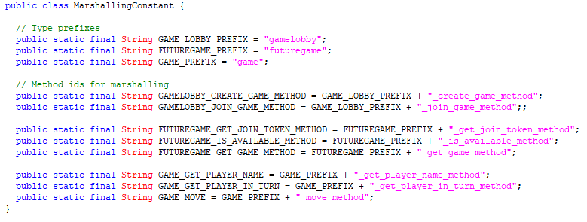
Marshalling Matters
So, I have actually prepared for this in my marshalling
Three classes and three prefixes on the method names

Slide 7
Name Mangling
My method names includes the name of the class

Slide 8
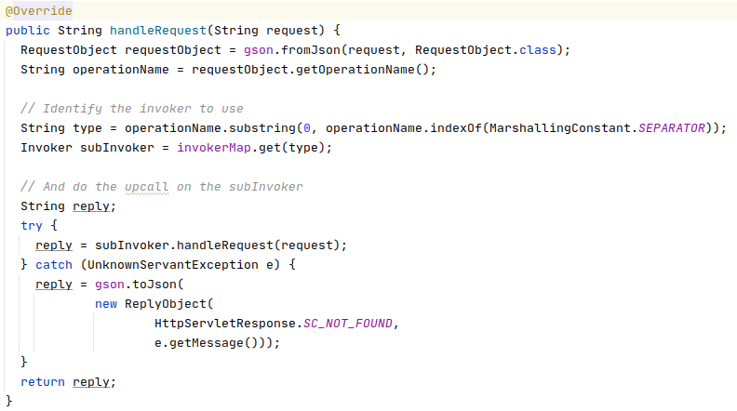
So, I Delegate
The Invoker simply looks up the associated Invoker
Extract the class name

Slide 9
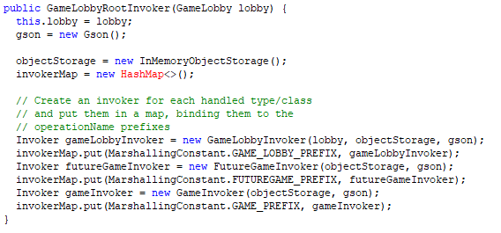
Setting up the Lookup
Have to initialize the root invoker

Slide 10
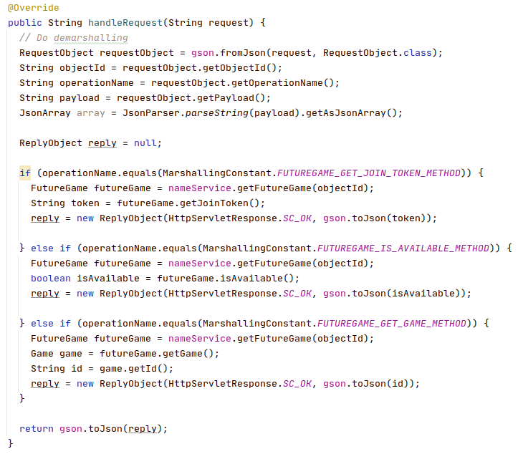
Smaller, Type-specific, Invokers
Achieve high cohesion in the type specific invokers

Slide 11
[SideBar]
Many, very similar, methods can be lambda’ed a lot☺
In my CardInvoker, I just have a mapping from OperationName to f(card): ReplyObject
In my ‘handleRequest()’ I do little else but just lookup and apply
… on a configured function map

Slide 12
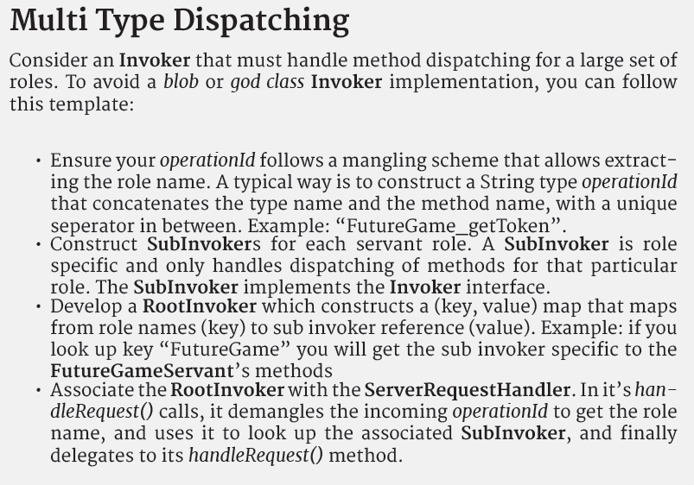
Process
Conclusion:

